Slide 1
12. Classical statistics

Slide 2
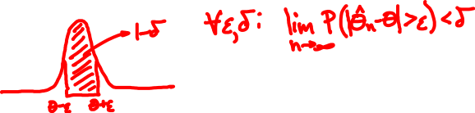
Estimators
X = (X₁, …, X_{n}) independent samples
^
Unbiased: E[Θ_{n}] = θ
^
Consistent: Θ_{n} converges to θ in probability

Slide 3
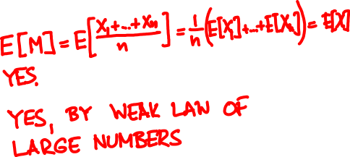
Estimating the mean
X = (X₁, …, X_{n}) independent samples of X
^
M = (X₁ + … + X_{n}) / n
Unbiased?
Consistent?

Slide 4
Maximum likelihood
Bayesian MAP estimate:
maximize f_{Θ|X}(θ | x) = f_{X|Θ}(x | θ) f_{Θ}(θ)
Classical ML (maximum likelihood) estimate:
maximize f_{X|Θ}(x | θ)

Slide 5
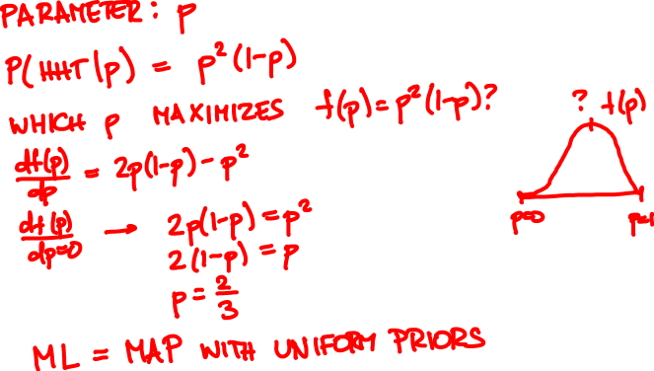

Coin flip sequence HHT. What is ML bias estimate?

Slide 6
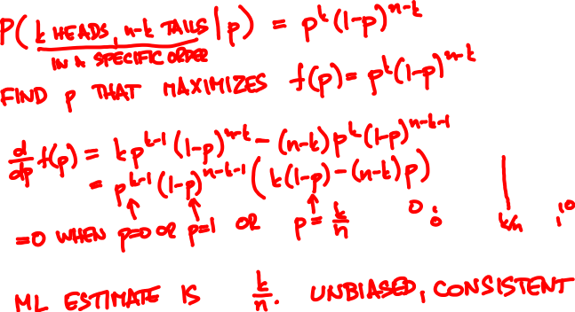


Maximum likelihood for Bernoulli(p)
k heads, n – k tails. ML bias estimate?

Slide 7


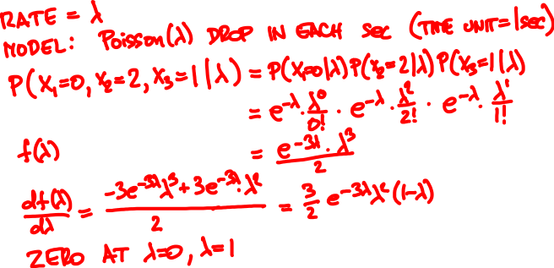
Within the first 3 seconds, raindrops arrive at times 1.2, 1.9, and 2.5. What is the estimated rate?
0
3

Slide 8

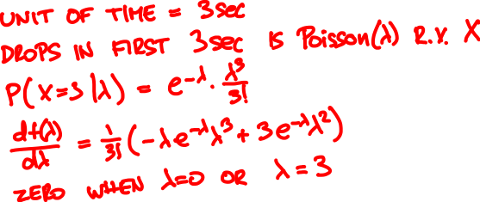
Within the first 3 seconds, raindrops arrive at times 1.2, 1.9, and 2.5. What is the estimated rate?
0
3

Slide 9

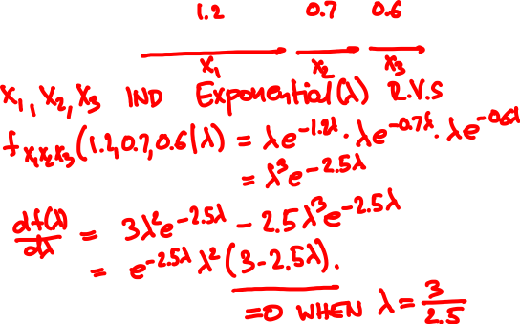
The first 3 raindrops arrive at 1.2, 1.9, and 2.5 sec. What is the estimated rate?
0

Slide 10
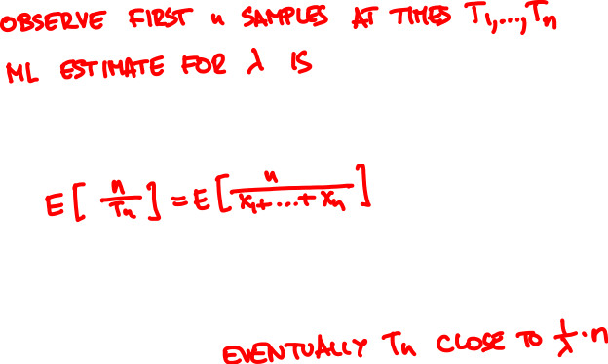
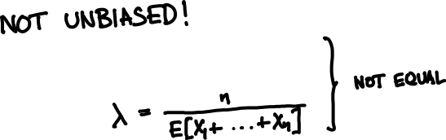

Maximum likelihood for Exponential(λ)

Slide 11



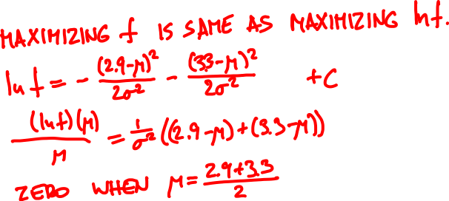

A Normal(μ, σ) RV takes values 2.9, 3.3. What is the ML estimate for μ?

Slide 12
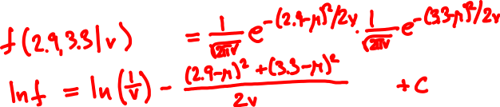
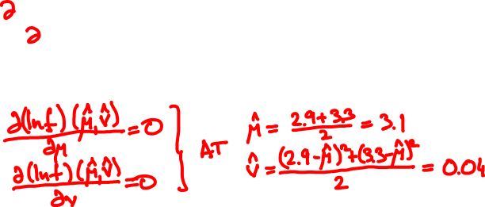
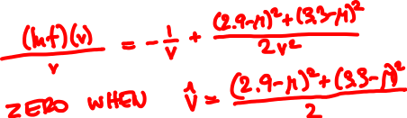
A Normal(μ, σ) RV takes values 2.9, 3.3. What is the ML estimate for v = σ²?

Slide 13

Maximum likelihood for Normal(μ, σ)
(X₁, …, X_{n}) independent Normal(μ, σ)
^
^
Joint ML estimate (M, V) of (μ, v = σ²):
^
X₁ + … + X_{n}
M =
n
^
^
^
(X₁ – M)² + … + (X_{n} – M)²
V =
n

Slide 14
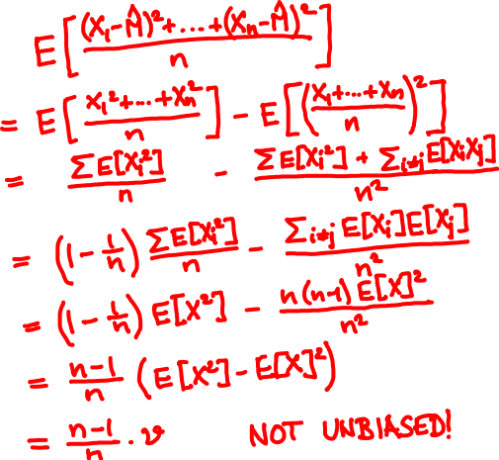
^
E[V] =

Slide 15
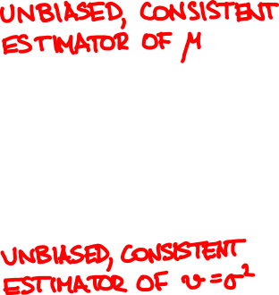
(X₁, …, X_{n}) independent Normal(μ, σ)
^
X₁ + … + X_{n}
M =
n
n
^
^
^
(X₁ – M)² + … + (X_{n} – M)²
V =
n – 1
n – 1

Slide 16
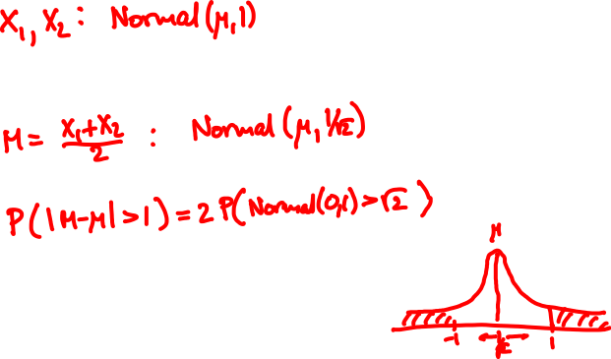
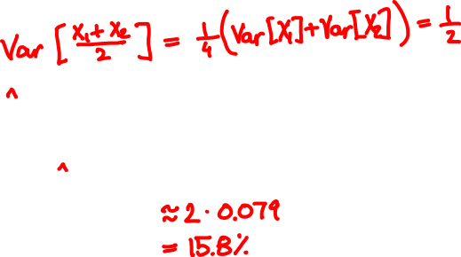
A Normal(μ, 1) RV takes values X₁, X₂. You estimate the mean by M = (X₁ + X₂)/2. What is the probability that |M – μ| > 1?
^
^

Slide 17
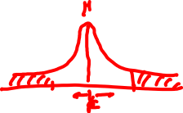
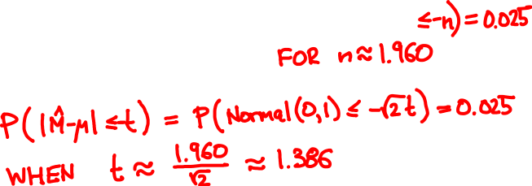

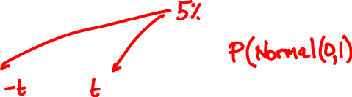

^
For which value of t can we guarantee |M – μ| ≤ t with 95% probability?

Slide 18

Confidence intervals
^
^
A p-confidence interval is a pair Θ₋, Θ₊ so that
^
^
P(θ is between Θ₋ and Θ₊) ≥ p

Slide 19


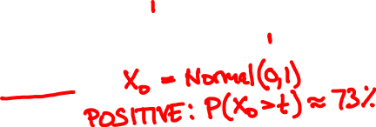
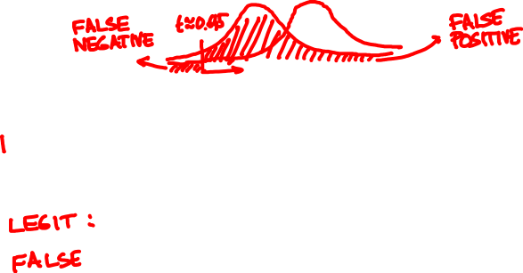

An car-jack detector outputs Normal(0, 1) if there is no intruder and Normal(1, 1) if there is.
You want to catch 95% of intrusions. What is the probability of a false positive?

Slide 20
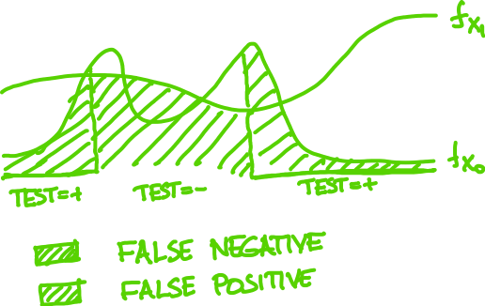
Hypothesis testing

Slide 21
Neyman-Pearson Lemma
Among all X₁/X₀ tests with given false negative probability, the false positive is minimized by the one that picks samples with largest likelihood ratio
f_{X} (x)
₁
f_{X} (x)
₀

Slide 22

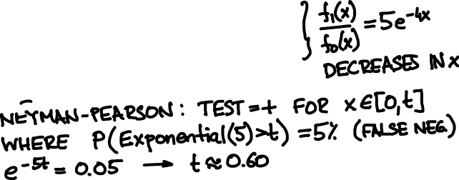

Rain usually falls at 1 drop/sec. You want to test today’s rate is 5/sec based on first drop. How to set up test with 5% false negative?

